Slide 1
Frankin Templeton Fixed Income
Securitized Products Group
Leveraging AI in Securitized Products
Presented by
Someshwar Marepalli, CFA, CAIA
Vice President
Franklin Templeton

Slide 2
Agenda
Agency Mortgage-Backed Securities
US Residential Mortgages
Collateralized Loan Obligations
Commercial Mortgage-Backed Securities

Slide 3
Agency Mortgage-Backed Securities

Slide 4
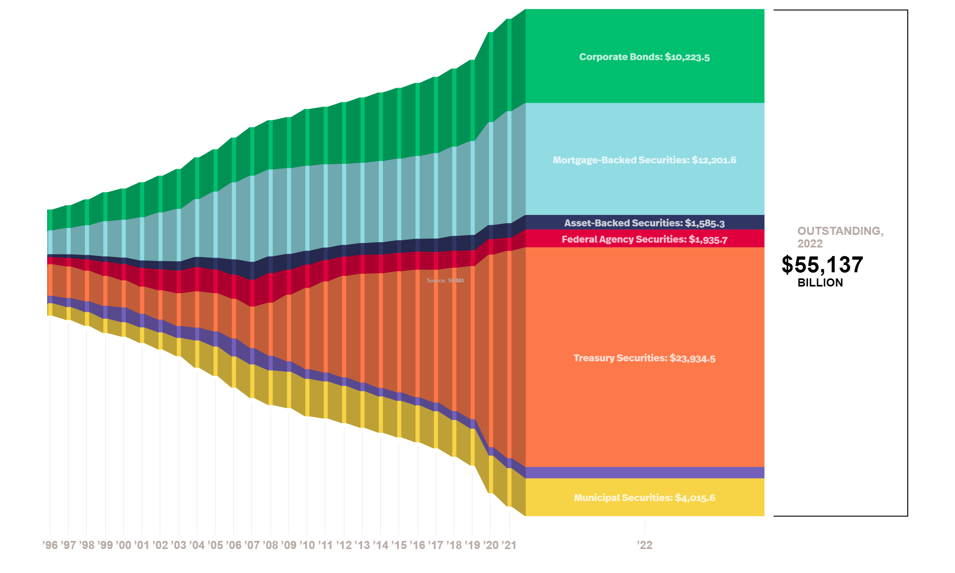
Agency Mortgage-Backed Securities
  Fixed Income Market Overview
    Mortgage-Backed Securities constitute the second largest fixed-income sector (behind Treasuries) in the US market.
Source: SIFMA Research

Slide 5

Agency Mortgage-Backed Securities
  MBS Overview
What are Mortgage-Backed Securities (MBS)?
    A mortgage-backed security (MBS) is a fixed income security representing an ownership interest in a pool of residential mortgage loans.
    A residential mortgage is a loan issued by an originator, such as a bank, to a borrower for the purpose of purchasing a residential property.
    Residential homeowners make mortgage payments which are pooled each month, and “passed through” to MBS holders in the form of principal and interest cash flows.
source: Investopedia
    MBS – A bond secured by a bundle of home loans.

Slide 6
Agency Mortgage-Backed Securities
  Risks
Prepayment Risk
    The primary risk in the agency MBS market is prepayment risk, the risk of uncertain cash flows caused by prepayments in the pools’ underlying mortgages as most residential mortgages originated in the U.S. provide the borrower with the option to prepay some or all of their outstanding principal balance on their loans at any time.
Conditional Prepayment Rate (CPR)
    A CPR is an estimate of the percentage of a loan pool’s principal that is likely to be paid off prematurely.
Source: embs

Slide 7
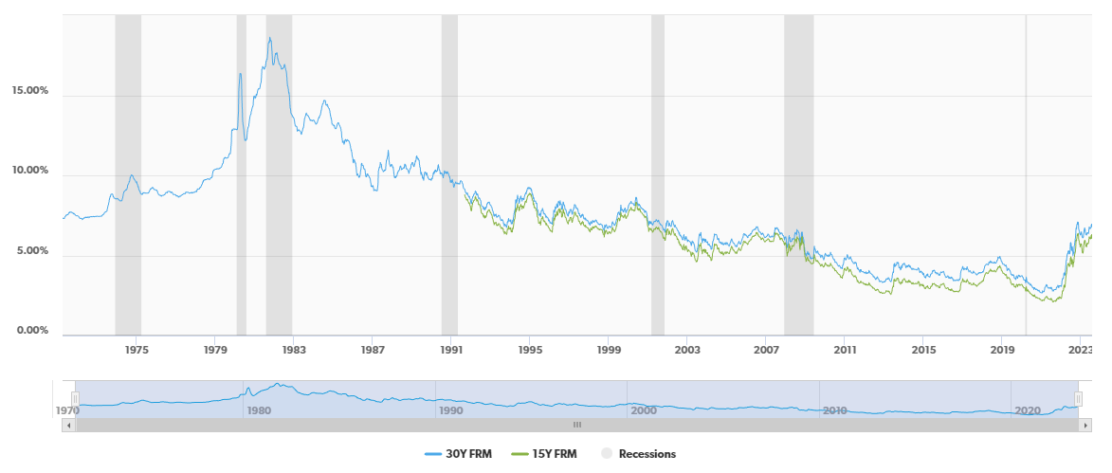
Agency Mortgage-Backed Securities
  Prepayments
    Catastrophes / Natural Disasters
    Industry Exposure
    Servicers
    Government / Legal Reforms
Drivers of prepayments
    Mortgage Rates
    Collateral Characteristics
    Turnover
    Seasonality
Primary Mortgage Market Survey Rate
Source: Freddie Mac
Notes:
Mortgage Rates
Rate Incentive to Refinance Loans at lower rates
Delinquency / Default due to higher rates
Collateral Characteristics
Credit Score, Geography, Loan Balance
Loan to Value Ratio, Loan Age
Catastrophes / Natural Disasters
Delinquency Rates might increase in area affected by Natural Disasters
Industry Exposure
Some states are heavily exposed to certain industries such as the oil Industry, where delinquencies might rise from job losses due to lower prices of oil

Slide 8
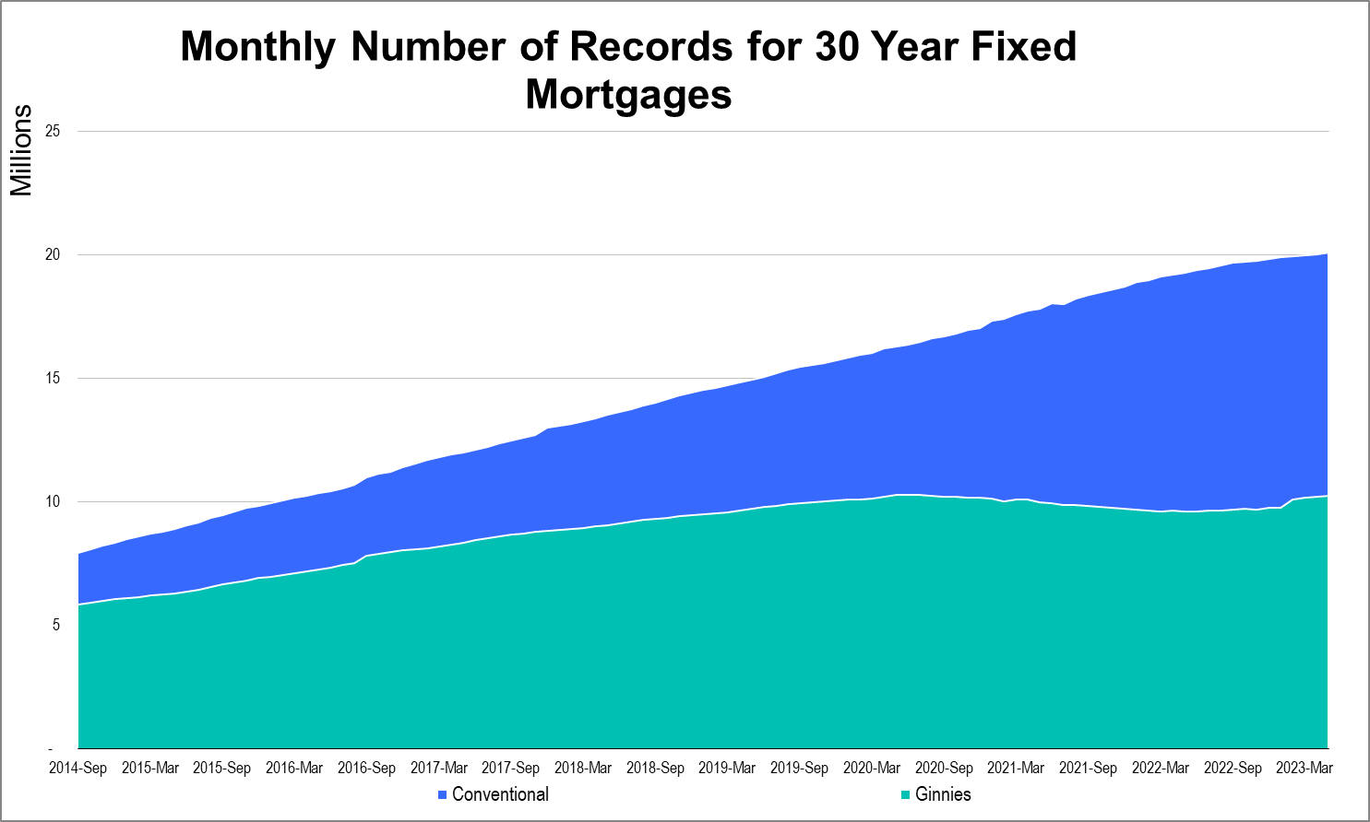
Why ML in Agency MBS
  Data Availability and Scale
    Long history and large amount of data
    The long history and large amount of data available in MBS make it a prime candidate to leverage machine learning (ML) algorithms to better explain complex relationships between various macro- and microeconomic factors and MBS prepayments
  Magnitude of Data
  20 million records for Conventional
  10 million records for Ginnies
  Over 1 billion data points.
  Long history that goes back to late 2000.
Source: embs
Notes:
Why invest in MBS?
With a total outstanding balance of more than $8 trillion, agency mortgage-backed securities (MBS) represent the second largest segment of the US bond market and the second most liquid fixed-income market after US Treasuries. Institutional investors have long participated in this market to take advantage of its attractive spread over US Treasuries, low credit risk, low transaction cost, and the ability to transact large quantities with ease.
2. MBS are made of individual mortgages extended to US homeowners.
3. The defining feature of this market are its large size, low credit risk, and the presence of prepayment risk.
4. Prepayment risk is the risk to investors of receiving unscheduled, early principal payments. It is a feature of investing in MBS caused by the mortgage borrowers’ ability to pay off their mortgages at any time. When principal is returned earlier than expected, investors tend to lose the premium over face value paid and, because mortgage prepayments tend to increase as interest rates decline, investors receive principal in a lower yielding environment. Those cashflows received need to be deployed at lower prevailing rates, leading to reinvestment risk. One might think of agency MBS as akin to Treasuries with embedded call options written to borrowers. To compensate investors, agency MBS often yield 50–100 basis points (bps) in return to Treasuries of similar duration. Mortgage prepayments are at the heart of all agency MBS valuation and analysis.
5. In addition to rate refinances, all the following actions result in prepayments:
Existing home sales: The sale of a home results in mortgage prepayment.
Cash-out refinances: Refinancing into a larger loan results in prepayment.
Defaults: Because of the agency guarantee, a foreclosure registers as prepayment.
Curtailments: Some borrowers pay excess principal each
6. For recent months, we have over 20 million records for Conventional and 10 million records for Ginnies. Over 50 variables used for model training. So over 1 billion data points.
7. Take UMBS-30 year model as an example. The model is trained on more than 2 billion records covering the period from 2009 to the present. Freddie Mac began releasing loan-level data in 2007, and FNMA and Ginnie Mae began doing the same in 2013.
Steve jobs put the macbook air into an envelope, people are like wow, that’s is super thin. It’s hard for human brains to understand vague numbers, so let’s try to put it into something that we can understand it better.
10 oranges to fill a salad bowl, 1 thousand oranges to fill a truck, 1 million to fill a swimming pool, and 1 billion to fill an entire stadium
1 million seconds is almost 12 days, a vacation, 1 billion seconds is 31 years (a career)

Slide 9
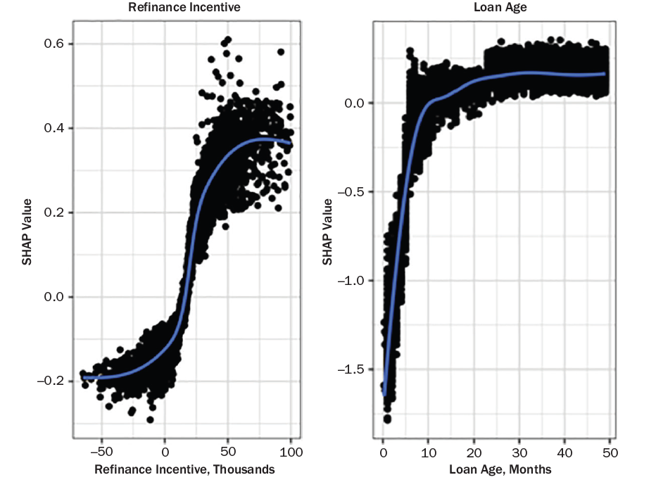
Why ML in Agency MBS
  Non-Linear Relationships
    Complex and dynamic relationship
    Given the complex and dynamic relationship between pool characteristics and prepayment, an ML model should capture the nuance better, given its ability to detect nonlinear patterns and that it is not confined to a certain functional form.
Source: Franklin Templeton
Notes:
SHAP values use game theory to determine the marginal contribution of each variable to the predicted output; in terms of prepayment modeling, it is the probability of a borrower prepaying within the analysis horizon.
The ML model does not provide the contribution of each variable to the prepayment prediction of the loan. A prediction can be explained by assuming that each attribute of a loan is a player in a game in which the prepayment prediction is the payout. SHAP values tell us how to fairly distribute the payout among the features.
To make it easier to compare, Exhibit 2 shows two relationships regarding prepayment similar to those in Exhibit 1. The left graph shows the relationship between refinance incentive and borrower likelihood to prepay, and the S-curve is visible. The right graph shows the relationship between loan age and borrower likelihood to prepay. Again, similar to Exhibit 1, the ramp is clearly shown. SHAP values are obtained for each loan-level prediction by perturbing the relevant input variable and observing the resulting change in output. Similar analysis can be applied to all variables in the ML model, which might help us to understand some less obvious relationships.

Slide 10
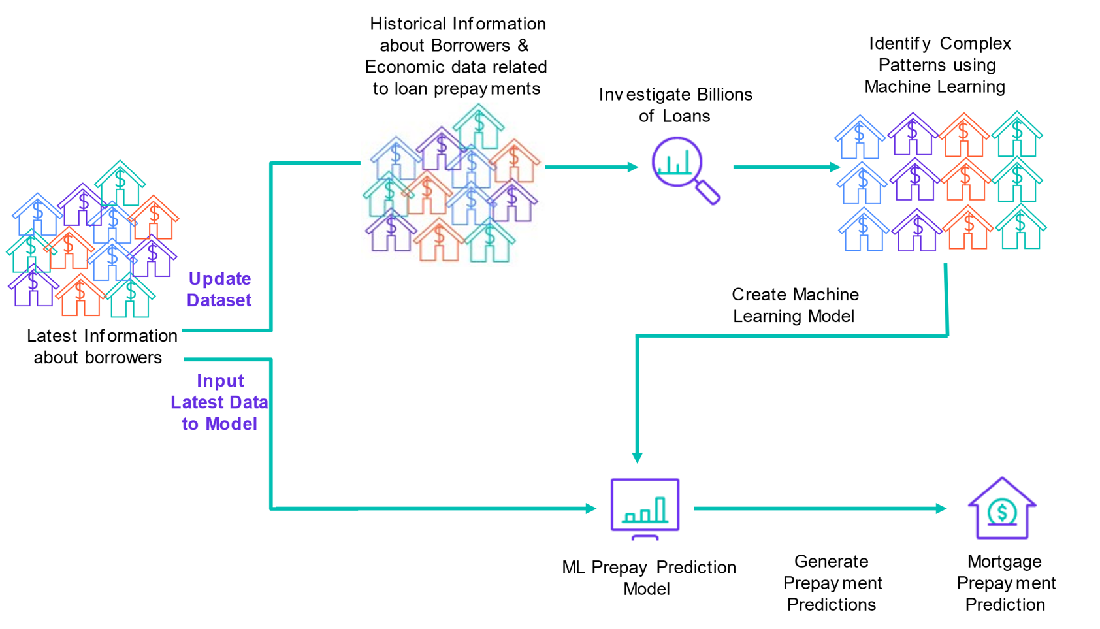
Model Construction
  Roadmap
    Macroeconomic: unemployment
    Microeconomic: application level, house value, affordability, permits issued for construction
    Loan level: remaining balance, credit score, loan to value ratio
    Unconventional data like (hit trend for certain key words)
Data
Source: Franklin Templeton
Notes:
A short-term prepayment model can be used to predict prepayment speeds over a near horizon, where the impact of interest rate volatility should be muted. Although this is not always the case, the assumption is not without foundation: Mortgage refinancing typically closes 30–45 days from application, and borrowers often shop lenders for better rates before locking in. Thus, a significant portion of the information needed to make an accurate short-term forecast is available. As a result, short-term models can be used to estimate plausible holding period returns over limited horizons.
The advantage of a dedicated short-term model is the ability to include a large number of variables that would be impractical to incorporate in longer term models. Long-term models require that all time-varying inputs be forecasted, for example, interest rates, volatility, housing prices, the level of unemployment, consumer confidence, and average wages, etc. As the number of inputs requiring forecasts grow, error accumulates. Given the complexity of long-term forecasts on model inputs, longer term models tend to use a smaller set of variables and can miss out on more nuanced signals.

Slide 11
US Residential Mortgages

Slide 12
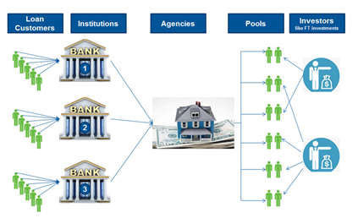
RMBS
  Model Roadmap
To create a framework for modeling default probabilities at loan level for US mortgage-backed securities (MBS)
Loan level probabilities aggregated to determine longer-term default behavior of different loan pools
Data
Loan level historical data (CRT STACR) with monthly loan performance and origination loan characteristics
Data size –
  10M + home loans
  500M+ monthly data
Macro economic data from FRED

Slide 13

Need for ML
Extensive volume of MBS data – 500M+ rows of data
Growing complexity of interrelationships among different factors influencing default behavior
Model
Leveraged Databricks by building 33 models together predicting probability of default over next 2 years for each loan
Each model is an Ensemble machine learning model using mathematically derived features using domain knowledge
Base and bear case scenarios which accounts for stressed economic environments i.e., GFC and global pandemic are modelled
Value-add
Default model setup gives a systematic and optimal approach to predict loan level defaults which helps in accessing and determining the cashflows in investment pools
Can be configured to include newer pools of loans and new factors which can potentially explain changing economic conditions.
Tailor made in-house model

Slide 14
RMBS
  Forecasting HPA
To forecast YoY change in the S&P Case Schiller Seasonally Adjusted Index (CSUSHPISA)
https://fred.stlouisfed.org/series/CSUSHPISA
How is it being used by Fixed Income team?
Data backed modelling approach
Designed to capture the level and direction of 12 month ahead US HPI forecasts basis change in multiple factors and regime shifts
Helps in portfolio positioning and portfolio sizing

Slide 15
Factors Used
Universe: 100 + Factors from FRED, grouped into different categories
1. Unemployment Related Factors
Interest Rate Related Factors
Housing Related Factors
Price Related Factors
Factors are added/removed from the overall pool basis their significance in the model and domain knowledge.
Certain factors are introduced from time to time and tested for their significance basis regime changes and macro level analysis.

Slide 16
Additional Benefit over the Industry models
Current approach offers a data driven model which can capture the evolving relationship between the home prices and the influencing factors.
Flexibility of understanding the extent and direction to which change in current factors influence home prices
Offers a what-if scenario testing where we can determine direction and level of forecast by changing factors influencing home prices.

Slide 17
Collateralized Loan Obligations (CLOs)

Slide 18
Introduction to Collateralized Loan Obligations (CLOs)
Broad Cash-Flow Mechanics
Typical CLO Structure
Assets are broadly syndicated senior secured corporate loans, and these provide the cash flow for the CLO structure.
Payments from the underlying loans are distributed to the CLO tranches in a sequential manner, starting with the most senior tranche.
In the event of loan defaults, any loss is absorbed in reverse order of seniority, starting with the equity tranche.
This structure provides a high degree of credit protection for senior tranches, as losses are absorbed by the lower-rated tranches first.
Collateral Manager
Underlying
Loans
Interest
& Principal
AAA
Payment Priority
Collateral Losses
AA
A
BBB
BB
Equity
Assets
Liabilities
Notes:
AAA – 36%
AA – 24%
A – 18%
BBB – 12%
BB- 8%

Slide 19
Why CLOs?
Asset Class Characteristics – Key Risks
Credit Quality | Optionality | Manager Performance | Liquidity
Underlying loans carry inherent credit risk Debt tranches cashflows may be impacted by loan defaults Severe market downturns can pose a threat to cashflows and price volatility However, historically senior tranches have experienced zero defaults, due to strong credit enhancement levels | Typically have a 2-year call protection, after which the equity holder may exercise their option to ‘call’ the deal in part or in full Debt investors either receive par on the called transaction or roll into replacement notes with potentially lower coupons This embedded call risk can limit price upside above par | Since CLOs are actively managed, the risk profile of the collateral pool changes over time Managers can significantly influence the performance of CLO tranches, highlighting the importance of manager selection | Liquidity varies with position in the capital structure and may be constrained in times of market stress Senior tranches are typically more liquid than mezzanine tranches

Slide 20

CLO Modeling Framework
Refi/Reset Model
Refinance/ Reset Model | Machine learning classification model that predicts near-term probability of a CLO refinancing or resetting. Factors Deal economics Collateral characteristics Manager size CLO’s current stage in the life cycle Aids in determining if a CLO aligns with a specific investment strategy and evaluates principal upside and downside scenarios (option or call-adjusted expected return) due to refinance or reset optionality. Output: Probability of a near-term refinance or reset
Notes:
US CLOs typically have a 2-year call protection, after which the equity holder(s) may exercise their option to refinance or reset the CLO’s liability structure.
Refinances involves lowering the debt cost of one or more tranches, in-line with the current term curve.
A reset extends the reinvestment period, typically to new issue term of 5-years and debt costs may also be decreased.
Debt investors either receive par on the ‘called’ transaction or roll into replacement notes with potentially lower coupons.
Gradient Boosting Machine (GBM) algorithm
Compression
Deals_in_RP
WAS_CUSHION
MOODY_WARR_CUSHION
SP_WARR_CUSHION
MIN_WARR_CUSHION
PCT_CAA1_OR_LESS_CUSHION
PCT_CCC_OR_LESS_CUSHION
PCT_CAA1_CCC_CUSHION
WARF_CUSHION
MOODY_DIV_SCORE_CUSHION
WAL_CUSHION
JrOC_CUSHION
BB_MVOC
EQ_NAV
RP_Days
NC_Days

Slide 21

CLO Modeling Framework
Pricing Model
Pricing Model | Machine learning-based model to reasonably estimate CLO tranche prices in an accurate and timely manner. Incorporates inputs from our manager and refinance/reset models Model trained using gradient boosting machine-learning algorithms on available pricing data, and additional factors: Tranche-level metrics (coupon, WAL, subordination, market value OC) Collateral quality metrics (weighted average price, WARF, diversity, etc.) Collateral concentration metrics (percentage of CCC loans, percentage of Illiquid loans) Apply a clustering algorithm to group similar bonds by rating level, then adjust prices based on observed secondary market trading within each cluster. Output: Tranche price estimations, and identifying comparable bonds

Slide 22
CMBS

Slide 23
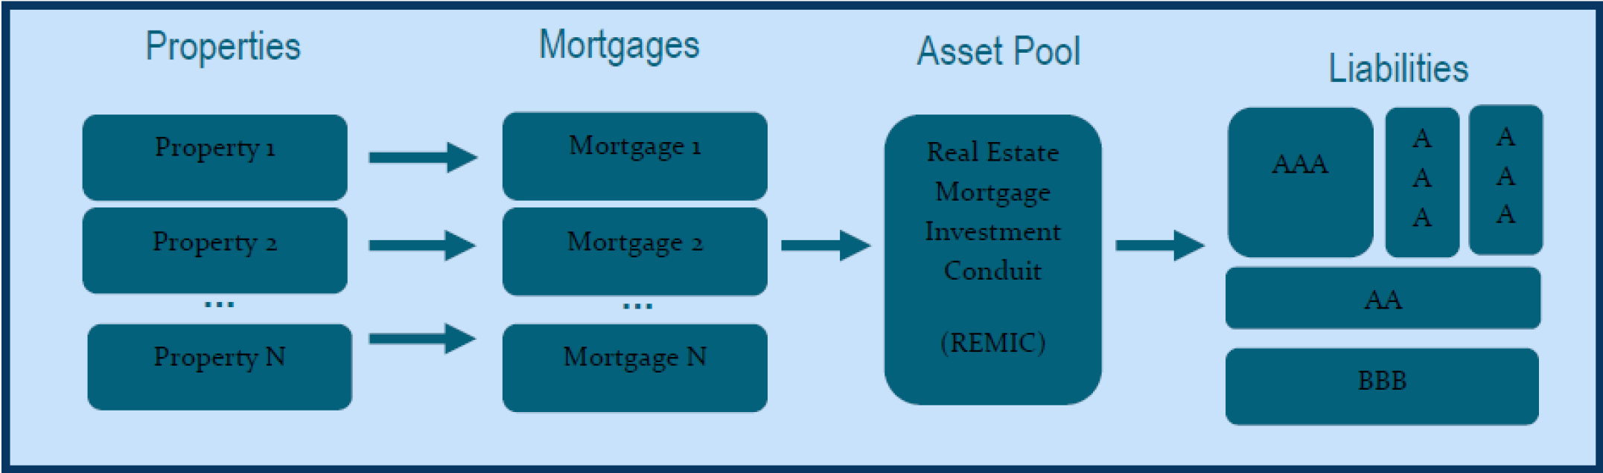
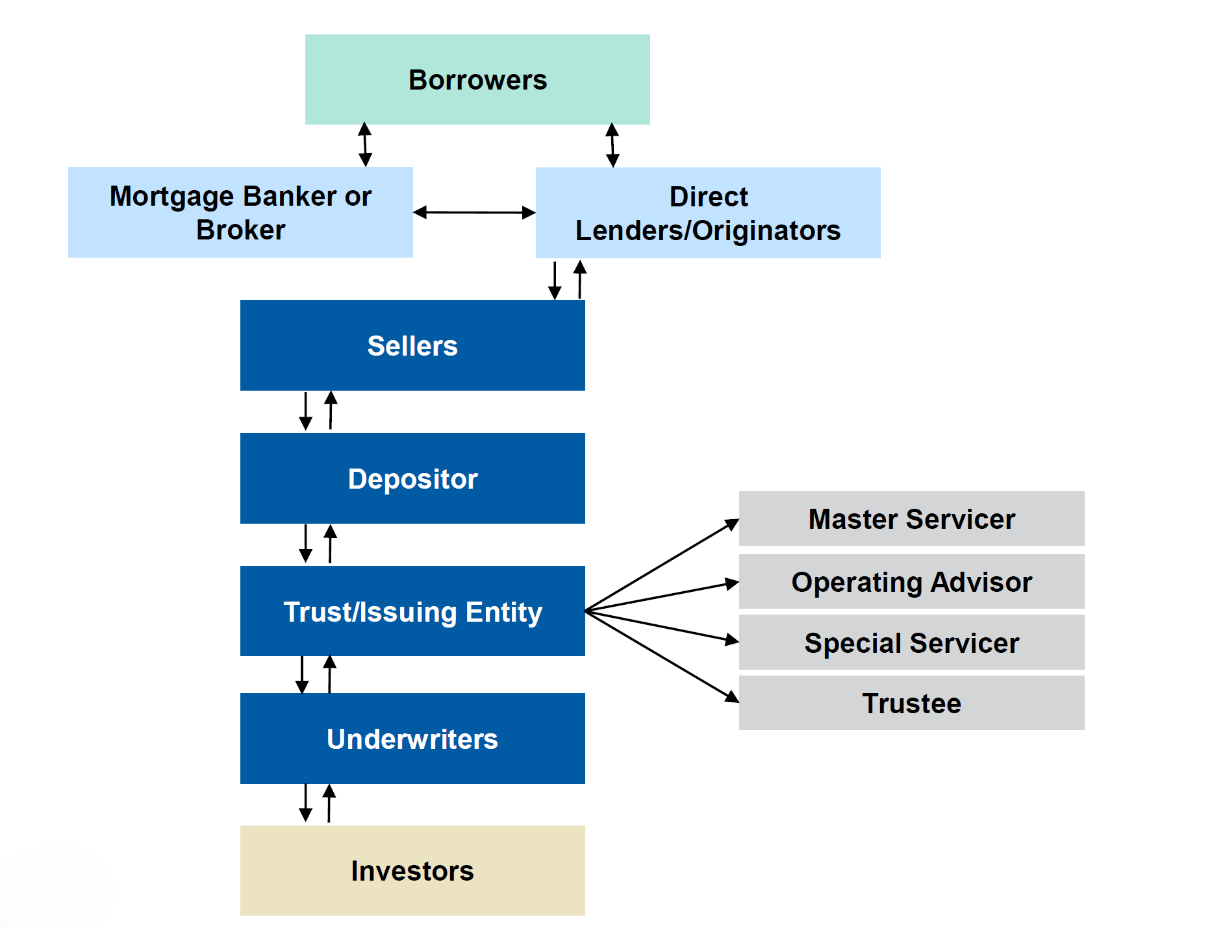
CMBS
Introduction
The commercial real estate (CRE) market consists of office, retail, warehouse, industrial, lodging, multifamily and manufactured housing properties.
As of Q1 2025, CMBS contributes ~11% of total US CRE mortgage debt outstanding, which is approximately 6.1 trillion dollars in aggregate
CMBS are bonds whose cash flows are derived from a loan or pool of loans secured by commercial real estate properties. There are two main structures that fall under the CMBS umbrella:
CMBS have a sequential pay structure so that collateral cash flows are allocated to the various tranches in order of seniority. Principal payments paid sequentially down the stack.
Principal losses are applied in reverse sequential order, affecting junior most bond first. There are also interest-only (IO) bonds as well

Slide 24
CMBS
ML Model
There are multiple opportunities to apply machine learning across the CMBS lifecycle, including identifying weakening loans, forecasting defaults, and estimating loss given default.
A loan can follow various financial trajectories through out it’s life:
Origination → Performing → Paid Off Normally at Maturity
Origination → Performing → WATCHLIST → Performing → Pays Off
Origination → Performing → WATCHLIST → SPECIAL SERVICING
Maturity Default → Special Servicing
Each loan can be analysed consistently over its lifecycle using the same underwriting variables and performance attributes.
We have around ~27K loans with their monthly signals till maturity, along with that we also have monthly level macro economic data points.
This makes a strong case of using ML for above mentioned use cases and many more. We can also leverage ML models across ABS

Slide 25
CMBS
ML Model
recurrent survival
multi-state transition model
UW Model
UW data
Monitoring Model
UW Vars
Temporal Loan Level data
Advance Monitoring
UW Vars
Temporal Macro Economic data
y = will loan be iffy given only UW vars
y = will loan be iffy in next k months (k = 12, 36)
Temporal Loan Level data
Temporal Macro Economic data
y, z = how long until it becomes iffy
rolling window

Slide 26
Questions?

Slide 27
IMPORTANT LEGAL INFORMATION
This material is intended to be of general interest only and should not be construed as individual investment advice or a recommendation or solicitation to buy, sell or hold any security or to adopt any investment strategy. It does not constitute legal or tax advice. This material may not be reproduced, distributed or published without prior written permission from Franklin Templeton.
The views expressed are those of the investment manager and the comments, opinions and analyses are rendered as at publication date and may change without notice. The underlying assumptions and these views are subject to change based on market and other conditions and may differ from other portfolio managers or the firm as a whole. The information provided in this material is not intended as a complete analysis of every material fact regarding any country, region or market. There is no assurance that any prediction, projection or forecast on the economy, stock market, bond market or the economic trends of the markets will be realized. The value of investments and the income from them can go down as well as up and you may not get back the full amount that you invested. Past performance is not necessarily indicative nor a guarantee of future performance. All investments involve risks, including possible loss of principal.
Any research and analysis contained in this material has been procured by Franklin Templeton for its own purposes and may be acted upon in that connection and, as such, is provided to you incidentally. Data from third party sources may have been used in the preparation of this material and Franklin Templeton (“FT”) has not independently verified, validated or audited such data. Although information has been obtained from sources that Franklin Templeton believes to be reliable, no guarantee can be given as to its accuracy and such information may be incomplete or condensed and may be subject to change at any time without notice. The mention of any individual securities should neither constitute nor be construed as a recommendation to purchase, hold or sell any securities, and the information provided regarding such individual securities (if any) is not a sufficient basis upon which to make an investment decision. FT accepts no liability whatsoever for any loss arising from use of this information, and reliance upon the comments, opinions and analyses in the material is at the sole discretion of the user.
Franklin Templeton has environmental, social and governance (ESG) capabilities; however, not all strategies or products for a strategy consider “ESG” as part of their investment process.
Products, services and information may not be available in all jurisdictions and are offered outside the U.S. by other FT affiliates and/or their distributors as local laws and regulation permits. Please consult your own financial professional or Franklin Templeton institutional contact for further information on availability of products and services in your jurisdiction.
Issued in the U.S.: Franklin Resources, Inc. and its subsidiaries offer investment management services through multiple investment advisers registered with the SEC. Franklin Distributors, LLC and Putnam Retail Management LP, members FINRA/SIPC, are Franklin Templeton broker/dealers, which provide registered representative services. Franklin Templeton, One Franklin Parkway, San Mateo, California 94403-1906, (800) DIAL BEN/342-5236, franklintempleton.com.
Brazil: Issued by Franklin Templeton Investimentos (Brasil) Ltda., authorized to render investment management services by CVM per Declaratory Act n. 6.534, issued on October 1, 2001. Canada: Issued by Franklin Templeton Investments Corp., 200 King Street West, Suite 1400 Toronto, ON, M5H3T4, Fax: (416) 364-1163, (800) 387-0830, www.franklintempleton.ca. Offshore Americas: In the US, this publication is made available by Franklin Templeton, One Franklin Parkway, San Mateo, California 94403-1906. Tel: (800) 239-3894 (USA Toll-Free), (877) 389-0076 (Canada Toll-Free) and Fax: (727) 299-8736. US: Franklin Templeton, One Franklin Parkway, San Mateo, California 94403-1906, (800) DIAL BEN/342-5236, franklintempleton.com. Investments are not FDIC insured; may lose value; and are not bank guaranteed.
Issued in Europe by: Franklin Templeton International Services S.à r.l. – Supervised by the Commission de Surveillance du Secteur Financier – 8A, rue Albert Borschette, L-1246 Luxembourg – Tel: +352-46 66 67-1, Fax: +352-46 66 76. Poland: Issued by Templeton Asset Management (Poland) TFI S.A.; Rondo ONZ 1; 00-124 Warsaw. South Africa: Issued by Franklin Templeton Investments SA (PTY) Ltd, which is an authorized Financial Services Provider. Tel: +27 (21) 831 7400, Fax: +27 (21) 10 344 0686. Switzerland: Issued by Franklin Templeton Switzerland Ltd, Talstrasse 41, CH-8001, Zurich. United Arab Emirates: Issued by Franklin Templeton Investments (ME) Limited, authorized and regulated by the Dubai Financial Services Authority. Dubai office: Franklin Templeton, The Gate, East Wing, Level 2, Dubai International Financial Centre, P.O. Box 506613, Dubai, U.A.E. Tel: +9714-4284100, Fax: +9714-4284140. UK: Issued by Franklin Templeton Investment Management Limited (FTIML), registered office: Cannon Place, 78 Cannon Street, London EC4N 6HL. Tel: +44 (0)20 7073 8500. Authorized and regulated in the United Kingdom by the Financial Conduct Authority.
Australia: Issued by Franklin Templeton Australia Limited (ABN 76 004 835 849) (Australian Financial Services License Holder No. 240827), Level 47, 120 Collins Street, Melbourne, Victoria 3000. Hong Kong: Issued by Franklin Templeton Investments (Asia) Limited, 62/F, Two IFC, 8 Finance Street, Central, Hong Kong. Japan: Issued by Franklin Templeton Investments Japan Limited. Korea: Issued by Franklin Templeton Investment Trust Management Co., Ltd., 3rd fl., CCMM Building, 12 Youido-Dong, Youngdungpo-Gu, Seoul, Korea 150-968. Malaysia: Issued by Franklin Templeton Asset Management (Malaysia) Sdn. Bhd. & Franklin Templeton GSC Asset Management Sdn. Bhd. This document has not been reviewed by Securities Commission Malaysia. Singapore: Issued by Templeton Asset Management Ltd. Registration No. (UEN) 199205211E and Legg Mason Asset Management Singapore Pte. Limited, Registration Number (UEN) 200007942R. Legg Mason Asset Management Singapore Pte. Limited is an indirect wholly owned subsidiary of Franklin Resources, Inc. 7 Temasek Boulevard, #26-03 Suntec Tower One, 038987, Singapore.
The views and opinions expressed are not necessarily those of the broker/dealer; or any affiliates. Nothing discussed or suggested should be construed as permission to supersede or circumvent any broker/dealer policies, procedures, rules and guidelines.
Please visit www.franklinresources.com to be directed to your local Franklin Templeton website.
Copyright © 2025 Franklin Templeton. All rights reserved.

